Slide 1




Case Studies in Data Science
Understanding mental health trends through data
Name: Pavitra Ramakrishnan
Student Id: s4159962
Mental Health Analytics

Slide 2



What is Mental Health?
Mental health refers to emotional, psychological, and social well-being.
It affects how we think, feel, and behave in daily life.

Slide 3


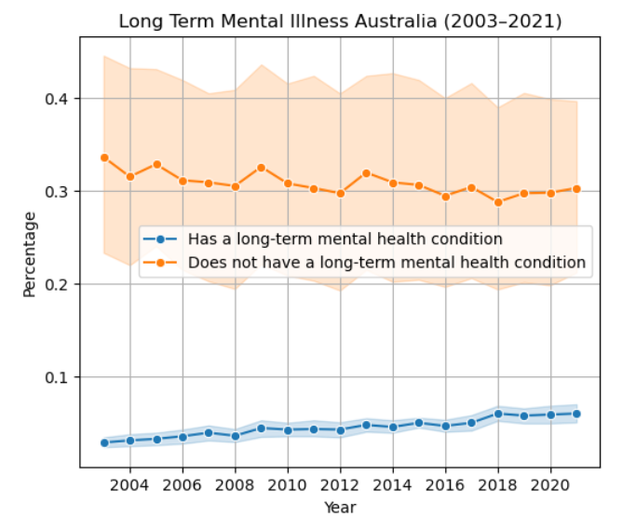
Australia’s mental health trends
While currently people reporting a long term illness is low, it is still demonstrating a significant rise over the past decade
According to the Australian Health and Welfare Government 1 in 5 australians experienced a mental health disorder accounting to more than 17% of the population

Slide 4


Impacts physical health and longevity.
Affects relationships and social interactions.
Influences productivity and success.
Why Mental Health Matters
Important for handling stress, relationships, and decision-making.

Slide 5



Problem Statement:
Health networks like SEMPHN need data-driven insights to plan services, allocate resources, and target interventions.
The aim of this project is to assess population local survey data to uncover mental health patterns
Can demographic and health-related factors reliably predict whether an individual is at risk of experiencing anxiety and/or depression?
Can an individual’s lifestyle habits help in predicting their mental health condition?

Slide 6


Datasets Used
Indicators of Stress and Anxiety (Kaggle)
Tracks mental health indicators in the U.S (helps get a holistic overview and track global trends)
Tracks it across various subgroups such as age, gender, education, race, LGBTQ+
Prevalence and Impact of Mental Illness (AIHW)
Contains statistics on the effects and occurance of mental health statistics across various demographic groups in Australia.
Out of numerous entries “Prevalence.6” sheet was chosen to report long term mental illness

Slide 7
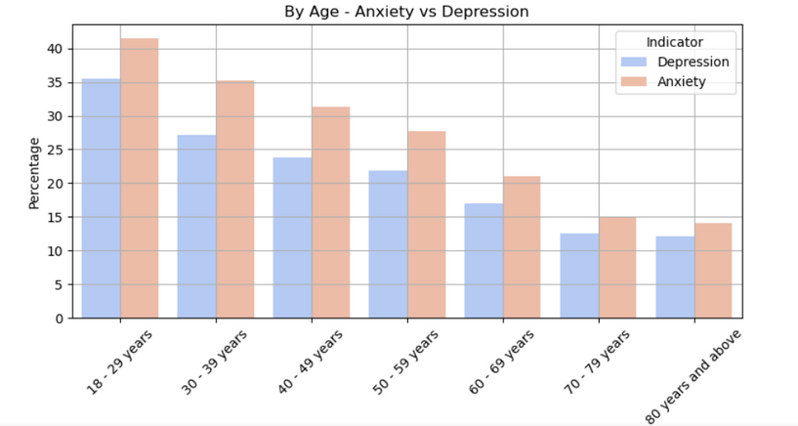
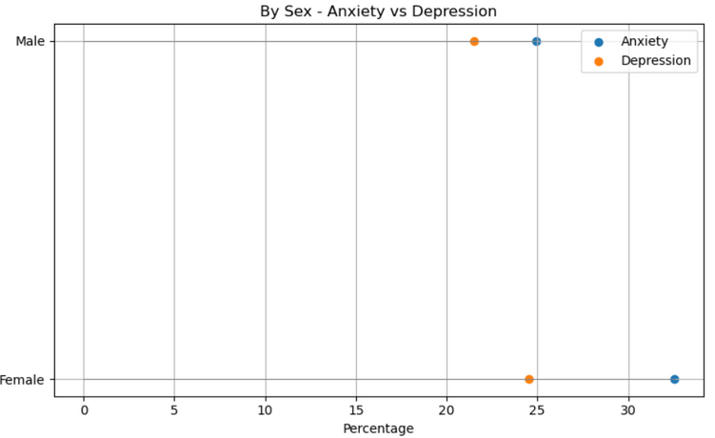
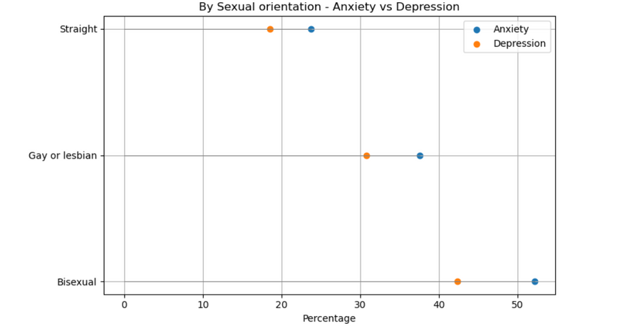
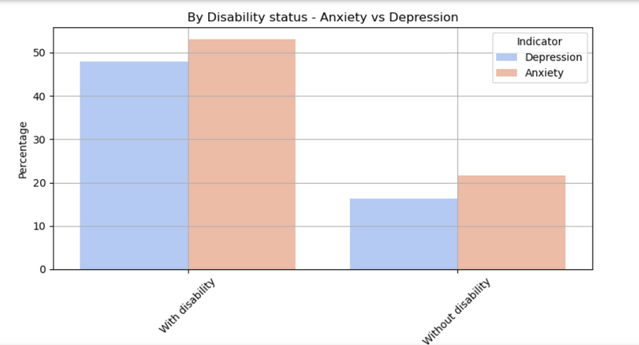
Insights into Anxiety and Depression Patterns
Young Adults (aged 18-29) report over 35% depression symptoms
Women show over 25% depression symptoms and 30% anxiety symptoms
Interestingly sexual preferences seemed to play a high role in causing distress with gay/lesbian and bisexuals observing a spike of over 30% and 40% in depression respecitvely.
People with disability show a depression rate of over 45%

Slide 8
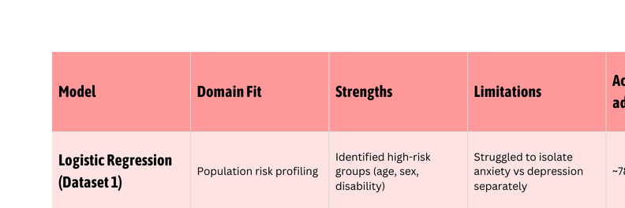
Modelling Insights
Logistic Regression | Decision Tree
Accuracy: 78% | Accuracy: 50%
Precision: 74% | Precision: 50%
Logistic Regression (Dataset 1):
Identified key risk groups (18–29 yrs, females, people with disabilities).
Stronger at detecting combined anxiety/depression, weaker at anxiety alone (class imbalance).
Accuracy: ~78% | Precision: ~74% | Recall: ~69%
Decision Tree (Dataset 2):
Practical for visualizing lifestyle factors.
Initially 95% accuracy
After SMOTE balancing: ~50% accuracy.
Indicates lifestyle features alone are not reliable predictors.

Slide 9

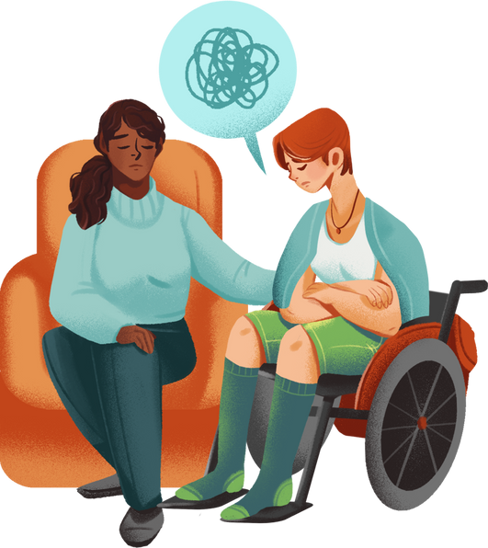



Conclusion and Recommendations
Women, young adults, transgender and people with disability reported having a significantly higher amount of stress and anxiety levels and also in some extreme cases depression against other groups
Demographics are strong indicators and directly give strong insights over mental health trends, however lifestyle alone cannot explain outcomes and should be covered with early childhood factors for better insights
Targeted Support: Women, young adults, transgender people, and those with disabilities need priority access to mental health services.
Stronger Representation: Regular surveys and inclusive data collection uncover hidden patterns in underserved groups.
Resource Allocation: Invest in professional help and early interventions to prevent severity in at-risk communities.

Slide 10
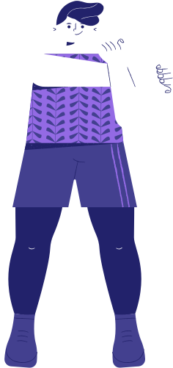


You Matter!
Your thoughts matter
Your feelings matter
YOU matter
Contribute with us to drive a human equitable system

